Slide 1

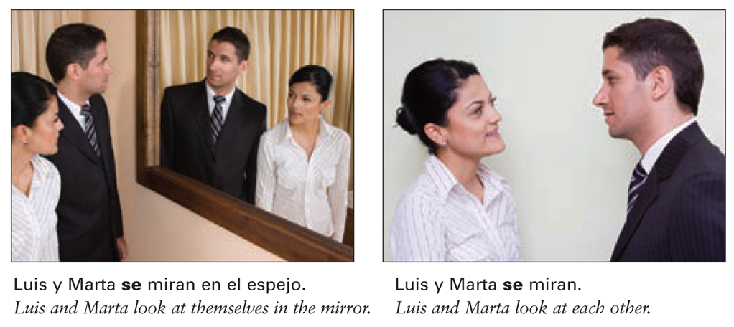
You have learned that reflexive verbs indicate that the subject of a sentence does the action to itself. Reciprocal reflexives (los reflexivos recíprocos), on the other hand, express a shared or reciprocal action between two or more people or things. In this context, the pronoun means (to) each other or (to) one another.
© by Vista Higher Learning, Inc. All rights reserved.
2.3-<number>

Slide 2
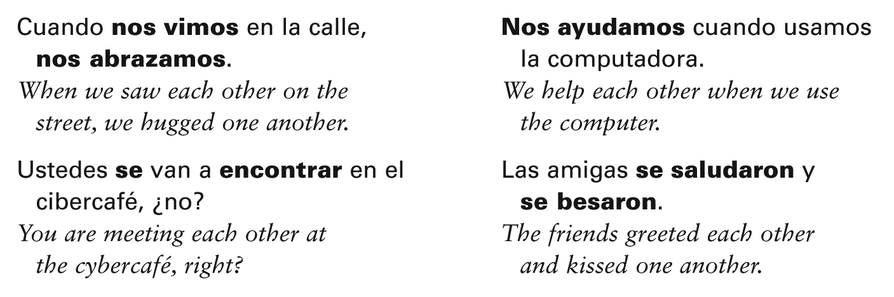
Only the plural forms of the reflexive pronouns (nos, os, se) are used to express reciprocal actions because the action must involve more than one person or thing.
© by Vista Higher Learning, Inc. All rights reserved.
2.3-<number>

Slide 3
¡Atención! Here is a list of common verbs that can express reciprocal actions:
abrazar(se) to hug; to embrace (each other)
ayudar(se) to help (each other)
besar(se) to kiss (each other)
encontrar(se) to meet (each other);
run into (each other)
saludar(se) to greet (each other)
© by Vista Higher Learning, Inc. All rights reserved.
2.3-<number>

Slide 4

Indica el reflexivo recíproco adecuado y el presente o el pretérito de estos verbos.
1. (escribir) Los novios __________. Nosotros _____. Ana y Ernesto _____. 2. (escuchar) Mis tíos _____. Nosotros _____. Ellos _____. 3. (ver) Nosotros _____. Fernando y Tomás _____. Ustedes _____. 4. (llamar) Ellas _____. Mis hermanos _____. Pepa y yo _____. | 1. (saludar) Nicolás y tú __________. Nuestros vecinos _____. Nosotros _____. 2. (hablar) Los amigos _____. Elena y yo _____. Nosotras _____. 3. (conocer) Alberto y yo _____. Ustedes _____. Ellos _____. 4. (encontrar) Ana y Javier _____. Los primos _____. Mi hermana y yo _____.
presente
pretérito
se escriben
se saludaron
© by Vista Higher Learning, Inc. All rights reserved.
2.3-<number>

